Slide 1
Product Price Tracker
Modern way to track your Wishlist

Slide 2
TABLE OF CONTENTS
01
05
Aim of the Project
Advantages
02
06
Disadvantages
Teconologies Used
03
Literature
Limitation
07
04
08
Flowchart
Future Work

Slide 3
Aim of Project
Nowadays, while online shopping we observe that the price of products changes day by day. Every customer likes to purchase their product at lower price.
The main objective behind this software is that, it will notify you whenever the original price of your selected product gets reduced. It will track your wish list and gives you notification via. E-mail.

Slide 4
TECHNOLOGIES USED
Python
Requests library
BeautifulSoup Library
Tkinter library
MySQL

Slide 5

LITERATURE
HERE ARE SOME EXPLAINATIONS :
1. Python : Python is an interpreted, object-oriented, high-level programming language. Its high-level built in data structures, combined with dynamic typing and dynamic binding, make it very attractive for Rapid Application Development, as well as for use as a scripting language to connect existing components together.
2. Tkinter (lib) : Tkinter is Python's GUI (Graphical User Interface) package. It is a thin object - oriented layer on top of Tcl /Tk. Tkinter is not the only GUI Programming toolkit for Python. It is however the most commonly used one.
3. Requests (lib) : Requests allow you to send HTTP/1.1 requests extremely easily. There’s no need to manually add query strings to your URLs, or to form-encode your PUT & POST data – but nowadays, just use the json method !

Slide 6
4. Beautiful Soup (lib) : Beautiful Soup is a library that makes it easy to scrape information from web pages. It sits atop an HTML or XML parser, providing Pythonic idioms for iterating, searching, and modifying the parser tree.
5. VS Code studio : Visual Studio Code is a free source-code editor made by Microsoft for Windows, Linux and MacOS. Features include support for debugging, syntax highlighting, intelligent code completion, snippets, code refactoring, and embedded Git.

Slide 7
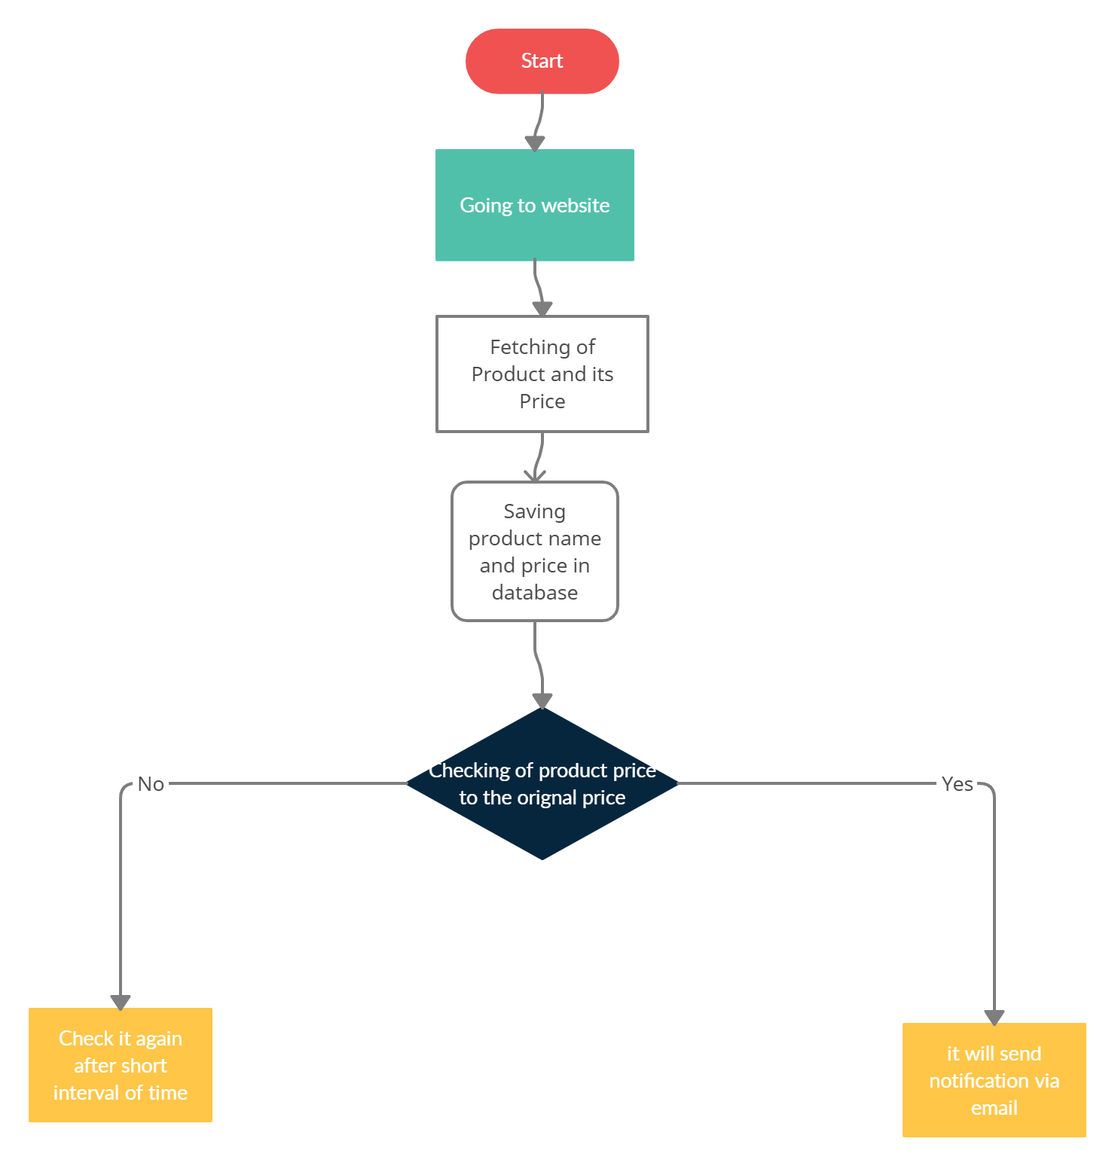
Flowchart

Slide 8
ADVANTAGES
It saves customer’s time as well as money.
It makes online shopping more flexible.
Software tracks selected product from any website. (Website must support web scraping)

Slide 9
DISADVANTAGES
Every time we want to add new website we have to makes some changes in code.
Software will take approx. 15 minutes to track product price again.

Slide 10
Some Websites doesn’t allow web scraping.
SOME LIMITTIONS
Website will block our IP address if we check in short interval of time.

Slide 11
FUTURE SCOPES
As for now it is a Desktop application but it has high scope in web technology as well as in the field of android application which can be accomplished easily.

Slide 12
THANKS!
Does anyone have any question?
Chinmay Jainouremail@freepik.com
+91 9589445122

